Slide 1
Learning is a lifelong evolution, teaching needs a revolution
Notes:
Starter: (1) who is still learning? Who feels the need to learn? (2) who is learning/studying in the same way as when you were at school?

Slide 2
Have we still enough skills to teach ?

Slide 3
Notes:
Objectives of the genY-project

Slide 4
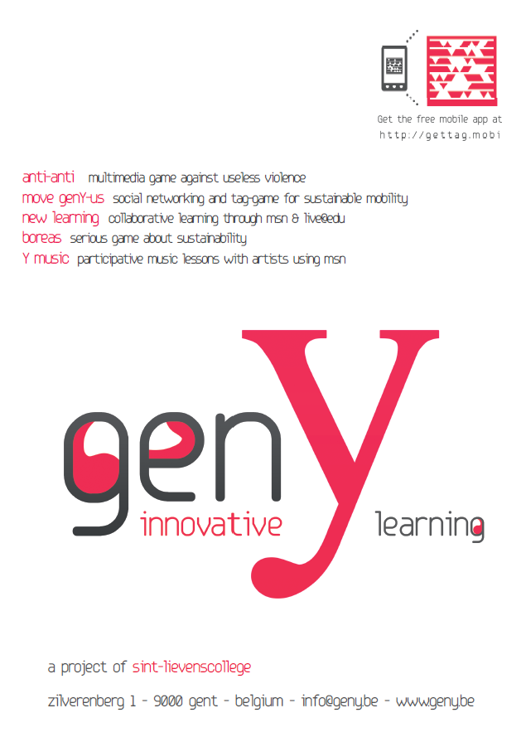

Slide 5
What about the national curriculum?

Slide 6
Our interest should be in the future, because our students are going to spend the rest of their life there.
Charles F. Kettering

