Slide 1
BG/BRG Klosterneuburg
BG/BRG Klosterneuburg in Lower Austria has been serving the local community formore than 100 years. Today, we offer local pupils an academic, well-rounded
general education which leads to the Austrian school-leaving certificate (AHS-Matura).

Slide 2
Web 2.0
We believe that Web 2.0 Learning with a central focus on ICT competences, issued together with the "Matura" at the end of the pupils’ final year, will decisively boost our pupils’ career opportunities in an increasingly international context.

Slide 3
eTeaching
We work with „Moodle“ in a fully switched Wireless Area.
http://www3.edumoodle.at/gymklbg/course/view.php?id=112
Every stundent has an account from the first day.
Teachers can use 60 Notebooks (belong to BG KLBG) for planning projects.
Special ICT knowledge (ECDL) at the age of 13

Slide 4
Lab activity
Science lessons /lab exercices at the age of 13.
Computer based lab training in Biology/Chemistry/Physics/ICT at the age of 17.

Slide 5
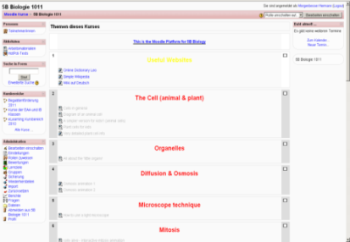
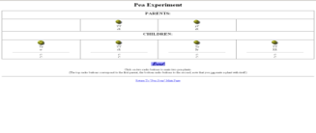
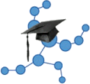
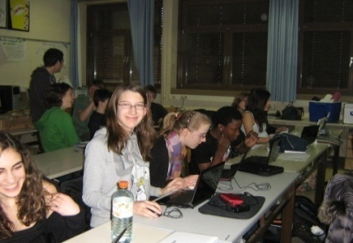
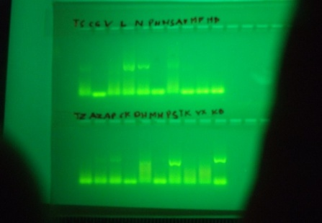
Model of Science teaching in BG Klosterneuburg AUSTRIA
Collect information:
Students figure out how the system of heredity works, using the “Interactive Pea Experiment“ on Scientix Webpage
Experiment:
An Expert from the University of Vienna shows how to screen Genetic Sequences
Presentation:
Students work out a Presentation using their netbooks
Topic: Summarize the information you got about the system of heredity
Review:
Students do an interactive Test in Moodle LMS

