Slide 1
Implementing 21st century ways of learning and schooling 12 May 2011, Roma
Panel 1:
Teaching & learning methods
Development of the cognitive sciences
Students as active agents of their own learning (co-construction of their knowledge)
Exchanging roles (temporarily) between students and teachers
Students learn together and from one another
Learning applied to real contexts

Slide 2
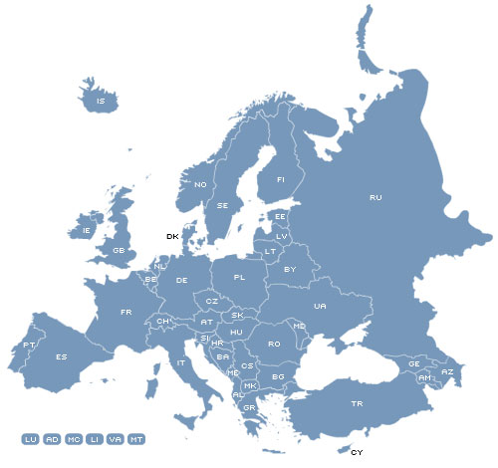
Immaculata Instituut
Oostmalle, Belgium
400 students
Vocational secondary education
Sint Lievens College
Gent, Belgium
950 students
General secondary education
NO Mittelschule Langenlois
Langenlois, Austria
390 students
General lower secondary education
BG-BRG Klosterneuburg
Klosterneuburg, Austria
1050 students
General secondary education

