Slide 1
Implementing 21st century ways of learning and schooling 12 May 2011, Roma
Panel 2:
Personalised teaching thanks to the innovative organization of time and space
Preferences for different methods and paces of learning between students
‘One size fits all’ no longer works
New organizational model of learning
The possibility of personalisation thanks to ICT

Slide 2
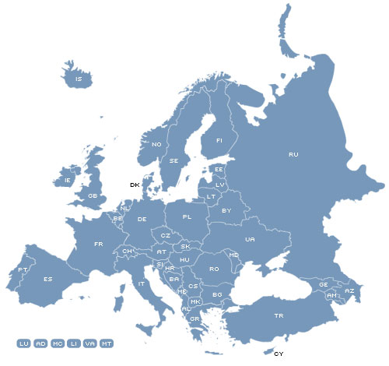
Hellerup school
Gentofte, Denmark
650 students
Primary & lower secondary education
Corlaer College
Nijkerk, The Netherlands
1400 students
Upper secondary education (general and vocational)
Lycée pilote innovant international
Poitiers, France
440 students
Upper secondary education

