Slide 1
Implementing 21st century ways of learning and schooling 12 May 2011, Roma
Panel 3:
Increasing schools’ involvement with their local communities
Learning ‘enters’ into the real world (contextualization), allowing students to become socially responsible citizens ready to enter the world of work
Multiplication of opportunities for the enrichment of students’ experiences
2 way approach: consolidate the support and commitment of the community to help students’ learning and likewise the school’s commitment to contribute to the community’s development
Students have the opportunity to showcase the results of their learning (valorization)

Slide 2
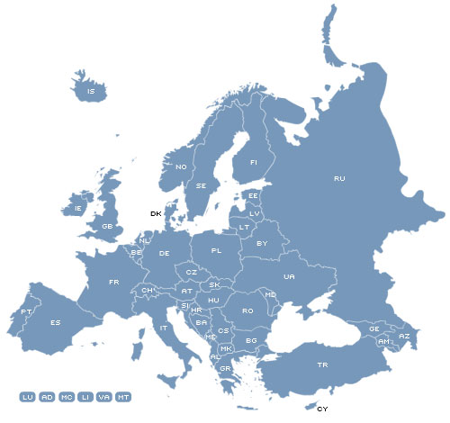
Broadgreen International School
Liverpool, United Kingdom
1300 students
Secondary education
Escola Domingos Sequeira
Leiria, Portugal
1200 students
Upper secondary education
IES Salvador Victoria
Teruel, Spain
270 students
Secondary education

